Slide 1
Art of Living Nepal
ABAN Talk series
“Healthy Living with Happiness”
The British Council Hall, Lainchaur, Kathmandu, Nepal
January 17, 2016

Slide 2
Happiness
Do all of us want to be happy ?
Y / N Mostly Y
Are we happy all the time ? Y / N
What makes us not be happy all the time ?
Work Pressure, Family problems- Relationship, Finance, Kids, parents, Neighbors, News, Views, Notions, Preferences, Work place relations, Targets,
Health………………………………………….

Slide 3
Health
Are we all healthy ?
Y ? N ? Don’t know
What is health really?
P, M, S
What makes us healthy ?
What makes you energetic ?

Slide 4
Sources of energy
Four Sources of Energy for Healthy
F
R
B
M M

Slide 5
Physical health
How we could say we are physically healthy ?
Lets Practice 2 short energizers
- Tips for Computer workers / Spondylitis cases
- Vastrika – The energizer
- Take slow breaths for a minute
What happened after two short energizers ?

Slide 6
Mental health
Nature of mind
- Oscillates between past and present
- Do not remain in present
- Clings to negative
- Questions the positive / truth
Living in present is necessary. But how ?

Slide 7
Meditation
Meditation helps both Physical and Mental health
Lets practice a short Meditation for 10/15 minutes
What is the state of mind right now ?
Sharing of experiences

Slide 8
AOl
About Aol
Vision:
"My vision is a violence-free, stress-free world." - Sri Sri Ravi Shankar
This can be achieved by having;
“Decease free body, Stress free mind and Violence free Society”
About Sri Sri Ravi Shanker
About Aol programs

Slide 9
About Aol Programs
ART EXCEL, YES, YES +, YLTP, YFT,
Waves of Happiness, Courses for Corporates, APEX
AMC
DSN
SSM
Social Programs..
-5H Program- (Home, Health, Hygiene, Harmony in Diversity and Human Values.), - Organic village, - Light a lamp, Rejuvenating rivers, VFAPN
Disaster Relief
Education
Rural Development
Prison Program
Women Empowerment
Environment
Peace and Many more…………………………………………..

Slide 10
About “Happiness Program”
Course elements include:
Practical knowledge to deal with the daily challenges of life
Interactive exercises
Yoga, stretching, and relaxation exercises
Meditation and powerful breathing techniques for peaceful mind
Sudarshan Kriya, a unique breathing technique, gift of Guru jee - Found only at AOL

Slide 11
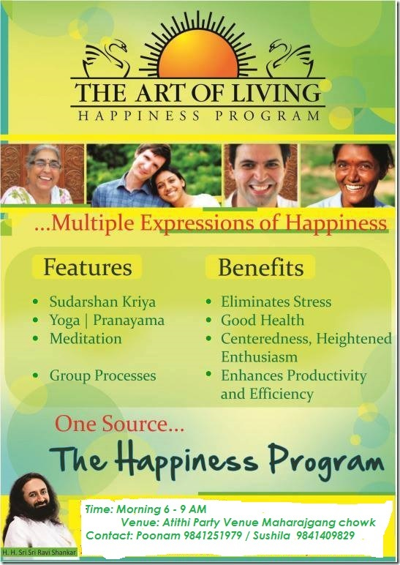

Slide 12
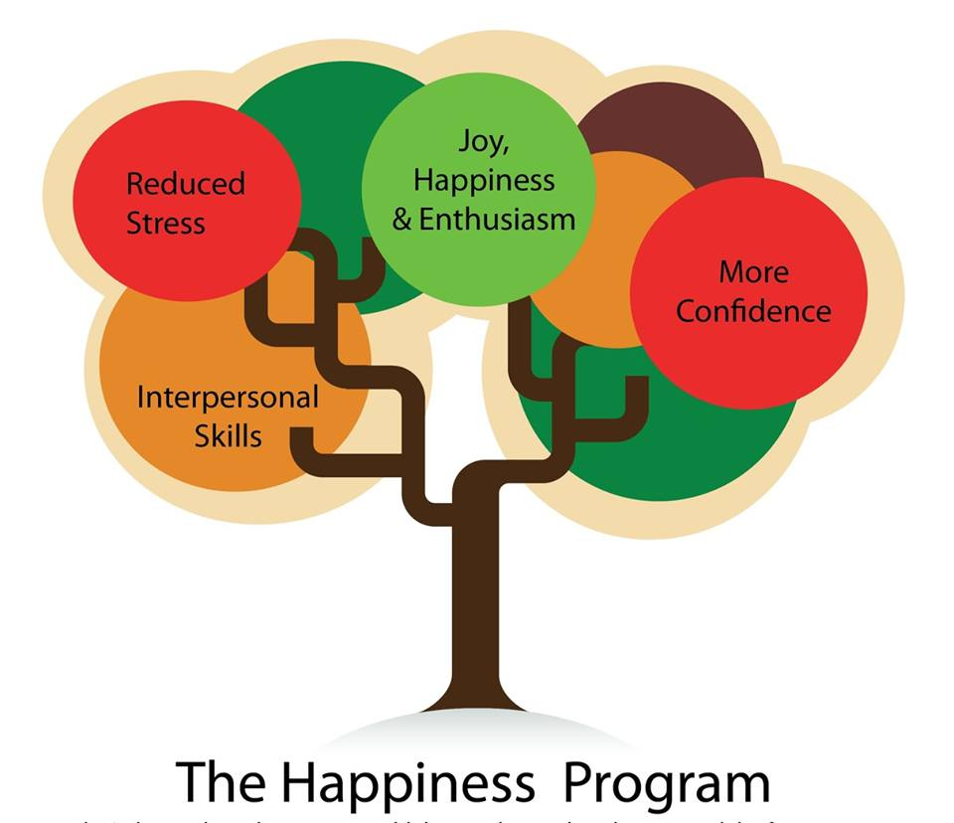

Slide 13
Previous Participant’s feedback
Reduced stress
More energy, joy and enthusiasm
Improved efficiency and productivity (at work and at home)
Greater self-esteem
Enhanced health and sense of well-being
Improved interpersonal skills
Clearer perception and decision-making
Shining expression and enhanced beauty
Anti-aging or rejuvenating effects

Slide 15
Sri Sri Speaks
If you turn your mind inward a little bit, and just observe what is happening inside you, you will always be happy. Unhappiness means you have gone away from Your Self. You have gotten caught up in the world outside of you. So take a step back, turn inward and look within, and then you find that 'you are happiness'.
'I want this & I want that'. Wanting something is what pushes happiness away.
Happiness is that which is in the present.

Slide 16
Sri Sri Speaks
Broaden your vision –
and know that life is much bigger than the small events and situations
You are responsible for your own happiness. Come what may, whoever says whatsoever, keep yourself happy.
Remember - 5 Ss that makes you always happy and smiling.

Slide 17
To Know more
Log in to:
artofliving.org
vfapn.org
At facebook: Art of living Nepal
Tulasi Uprety : Cell 9851053007
Email: t_uprety@yahoo.com
Poonam Uprety : cell 9841251979
Email: allwayshappypoonam@gmail.com
Thank you very much

