Slide 1
ROLE OF YOUTH IN SCIENCE, TECHNOLOGY AND INNOVATION IN NEPAL
Presented by
Prof. Dr. Jiba Raj Pokharel
Immediate Past Vice Chancellor
Nepal Academy of Science and Technology

Slide 2
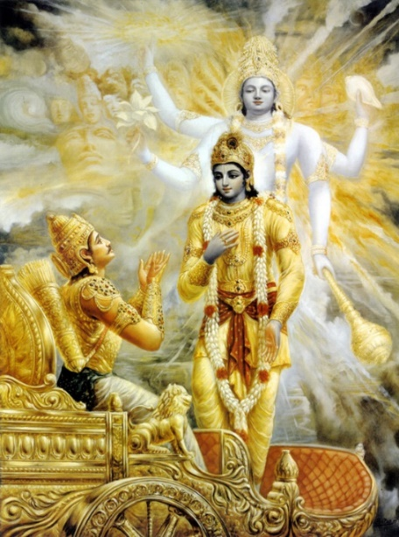
SCIENCE IN RAMAYAN AND MAHABHARAT
RAMAYAN(BC 5314)
1fg s'g slxG5 lkml/ s'g t slxG5 lj1fg, hflGbg s]xL d lj;] t 7"nf] 5 c1fg
GEETA
Ob+ t' t] u'Xotd+ k|jIofDo g;'oj] . 1fg lj1fg;lxt+ oH1fTjf df]Io;]sz'eft\
ltdLnfO{ ;lj1fg 1fg eG5' ;a} ;'g
h'g hfg] kl5 hfGg af“sL So} x'Gg ch'{g

Slide 3
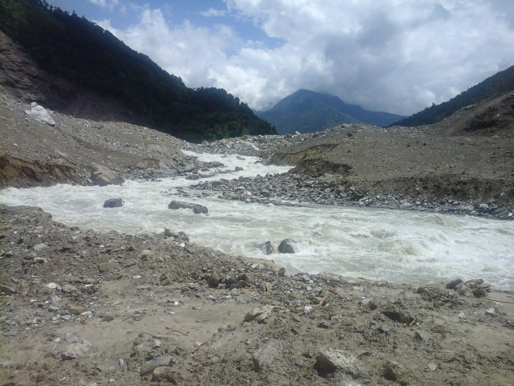
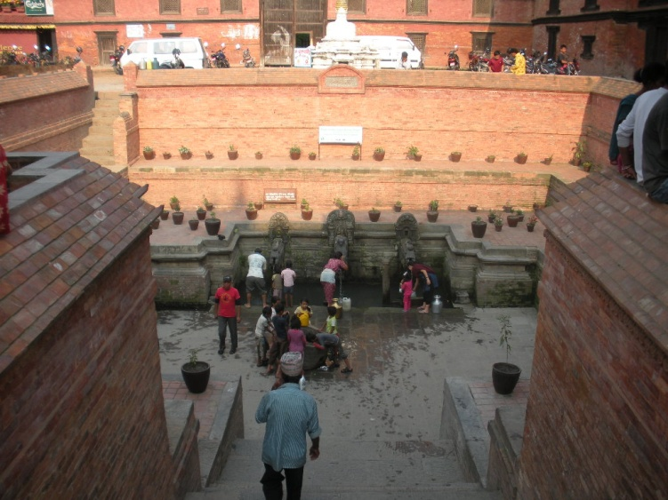
SCIENCE, TECHNOLOGY AND INNOVATION
SCIENCE IS ABOUT THE OBSERVATION OF NATURAL PHENOMENON AND MAKING THEORIES
To conclude that water flows downstream after observation of several flowing rivers is science
TECHNOLOGY IS ABOUT USING THE SCIENTIFIC THEORIES FOR THE BENEFIT OF THE MANKIND
To make a mud lined canal for drinking water or a mud lining canal for irrigation
INNOVATION IS ABOUT MAKING IT MORE EFFICIENT
- To lay pipe for reducing leakage
Science and technology is dominated by civil engineering and architecture

Slide 4
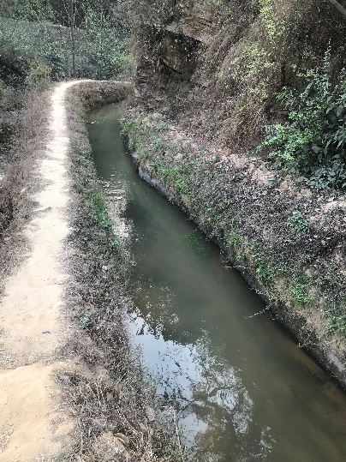
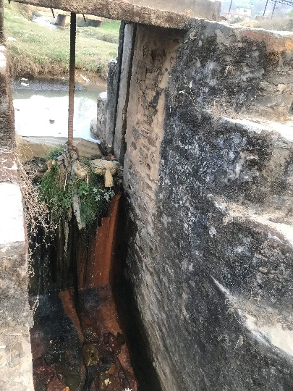
SCIENCE, TECHNOLOGY AND INNOVATION
RAJ KULO
Constructed before 6th century
Old Melamchi
Dam made under Lele river for Bhaktapur
From Mahadev Khola in Bhaktapur
From Siva Puri in Kathmandu

Slide 5
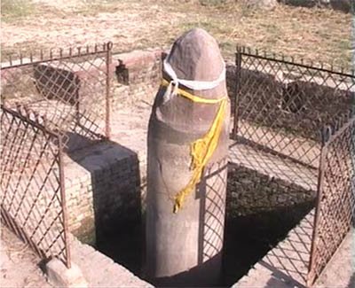
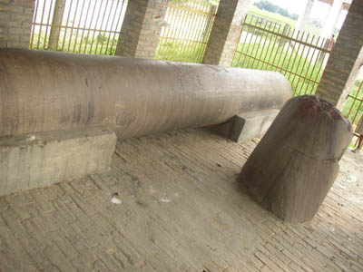
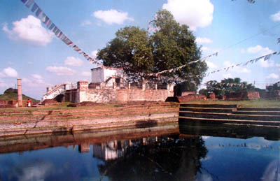
GOPAL AND KIRAT DYNASTY

Slide 6
PARTHENON AND KAILASH KUT BHAWAN
Poet Emmerson(1874)
Earth proudly wears the Parthenon, as the best gem upon her zone
Inscription of Snaga, 608
Kf[YjLtnsf] 6Lsf h:tf] ePsf], s'l/s'l/ nfu]sf b'lgofx¿n] cfvf lemd gu/]/ x]l/Psf]

Slide 7
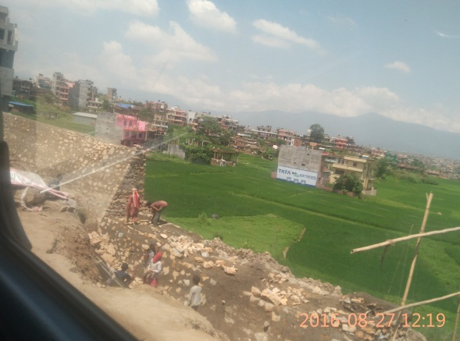
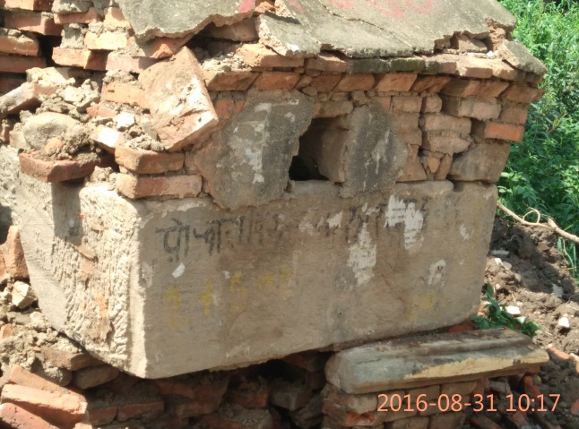
LICCHAVI PERIOD (Inscription of 826 AD)
Dff]tL6f/sf] clen]v
Kff6gaf6 n'e'lt/ hfFbf af6f]df df]tL6f/ eGg] 7fpF kb{5 . ToxfF a§]8f]n eGg] 7fpFdf af6fd} Pp6f hnb|f]0fL /x]sf] 5 . To;df of] clen]v s'FlbPsf] 5 .
! ç k~rfztf ;dlws] ;Dj:t/zt4o]
@ k|ydiff9df;:o låtLoflbj;]
# hnb|f]l0fl/o+ z}nL kflttf blIffd'vf
$ >Ldtfy anL/f1f /f1f k0oflej[4o]
;+jt @%) k|ydfiff9 dlxgf låtLofsf] lbg /fhf >L aln/fhn] k'0o a9f];\ egL of] 9Ë] hnb|f]0fL agfpg nfpg'eof]

Slide 8
MALLA TIMES
Aniko went to China and constructed the white pagoda in the year 1279.

Slide 9
MALLA TIMES
Nyata Pola constructed at 1702 by Bhupatendra Malla
Unaffected by earthquakes of 1767,1808, 1810, 1823,1833,1834,1837,1869, 1917, 1934, 1988, 2011, 2015

Slide 10
MALLA PERIOD: METALWORK
REFINED WORKMANSHIP IN METALWORK
ENTRY TO THE PALACE

Slide 11
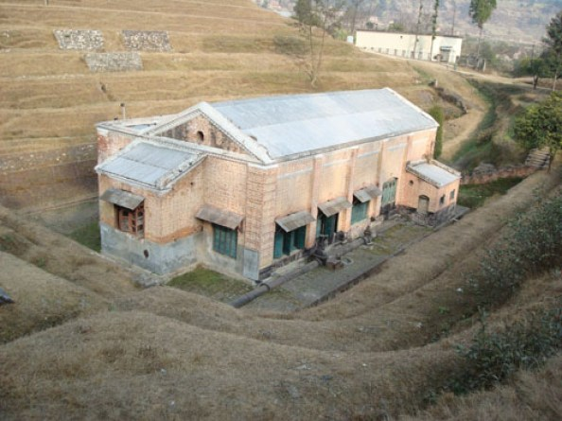
SHAHA AND RANA TIMES
Shahas were warriors and spent their time for the extension of territory
George Hamilton initiated research in botany
In the time of Ranas, Gehendra Shamsher appears as the first ever scientist of Nepal. He made a machine gun.
He died a premature death. It is said that he was fed with poison and his team mates Muse Thapa was banished and Tirtha Mishra was put behind the bars for seven years.
Farping hydro power station (1911)

Slide 12
RANA TIMES
Institution building
Agriculture office (1921)
Ayurved School(1929)
Civil Medical School for compounders and dressers(1934)
Technical Training School for Overseers(1942)
Forest Training Center for Rangers(1942)
Infrastructure building
Farping Hydropower station
Clock Tower
Suspension Bridge
Internal Telephone
Jute Mill
Victorian Buildings
Tri Chandra College
First Science School
Chandra Shasher
Jawahar Lal Nehru

Slide 13
SCIENCE AND PLANNED DEVELOPMENT
The first Five year Plan in 1956
The plan accorded due priority to
Scientific way of production
Scientific basis
Scientific research
Use of scientific knowledge and technology
Construction of roads
Department of Irrigation
Department of Hydrology and Meteorology
Department of Mines and Geology
Nepal Science Association
Phanindra Prasad Lohany, the first M Sc holder
Nepal Agriculture Association(1960)
Nepal Ayurvedic Association (1966)
Nepal Engineers Association (1967)
Nepal Veterinary Association (1967)

Slide 14
SCIENCE AND PLANNED DEVELOPMENT
The fourth and Fifth Five year Plan emphasized on industrialization
Nepal Industrial Development Corporation (1959)
National Council for Science and Technology(1976)
Royal Drug Research Laboratory
Royal Drugs Ltd
Royal Botanical Garden
Botanical Survey and National Herbarium
Plant Tissue Cultural Laboratory
Forest Research and Survey Center
Central Food and Research Laboratory
Herbs Processing and Production Ltd

Slide 15
SCIENCE AND PLANNED DEVELOPMENT
The Seventh Plan emphasized on meeting the basic needs of the people
Nepal Academy of Science and Technology was established
Need to create awareness of science and technology
Appropriate and indigenous technology
In the Eighth Plan period the Multi Party Democracy was restored
In the new constitution it was enshrined as follows
The state shall adapt policies rendering due priority to science and technology and the local technologies as well
Several Acts were enacted
Nepal Development Corporation Act, 1959
Patent Design and Trade Mark Act, 1965
Industrial Enterprise Act, 1981
Foreign Investment and Technology Act, 1981
Industrial Enterprise Act, 1982
RONAST Act, 1992
Aquatic Animals Protection Act, 1961
National Parks and Wild Life Conservation Act, 1973
Soil and Conservation Act, 1982
Forest Act, 1993
Establishment of New Ministry of Science and Technology

Slide 16
SCIENCE AND PLANNED DEVELOPMENT
The Ninth Plan focused on Poverty Alleviation
It also prepared a 20 year long term S and T Plan
It accorded great priority to develop alternate energy and promoting information technology
Popularizing and creating awareness for S and T
Stressing importance of R and D in all government and private institutions
Several Acts were enacted
Nepal Development Corporation Act, 1959
Patent Design and Trade Mark Act, 1965
Industrial Enterprise Act, 1981
Foreign Investment and Technology Act, 1981
Industrial Enterprise Act, 1982
RONAST Act, 1992
Aquatic Animals Protection Act, 1961
National Parks and Wild Life Conservation Act, 1973
Soil and Conservation Act, 1982
Forest Act, 1993
Establishment of New Ministry of Science and Technology

Slide 17
SCIENCE AND TECHNOLOGY POLICY
Need of science policy was felt since the sixties
But the first policy was prepared in 1988
It was endorsed by the Government in 1989
It clearly defined the objectives, priorities, plans of actions, strategies, infrastructure, administrative, financial measures, organizational framework and rescue mobilizations
It had focused on
proper resource utilization and development,
technology transfer,
quality manpower development and promotion,
extension and participation in S &T Development.
Despite this, it did not specifically mention about the implementing mechanism for example a separate ministry of Science and Technology.

Slide 18
SCIENCE AND TECHNOLOGY POLICY
After the establishment of the Ministry of Science and Technology, yet another Policy was framed.
Its objectives were
To enhance national capability by developing and utilizing knowledge, skill and competence in the field of Science and Technology
To contribute in the reduction of poverty by improving economic and social condition of the people at large through sustainable use of natural resources and means and conservation of the environment
To take the nation in competitive advantage by utmost development of Science and Technology.
It had four pronged S & T development approach through
Research and development
Technology transfer
Human resource development
S& T promotion development

Slide 19
SCIENCE, TECHNOLOGY AND INNOVATION POLICY-2076
Very recently the Science, Technology and now the Innovation Policy has been prepared
Its vision is science, technology and innovation for sustainable development and prosperity
It has committed to raise the investment of 1 per cent of GDP
Its objectives are
To raise the national production through the use of science, technology and innovation
To develop knowledge based entrepreneurship through the use of cutting edge technology, guarantee in investment and infrastructure development
To develop scientific expertise and technological manpower by upgrading and modernizing the indigenous technology, developing the scientific culture and research oriented education
It had the following working policies
Production and Production growth
Promotion of knowledge and manpower mobilization
Capacity development and promotion of entrepreneurship
Infrastructure Development and safety
Institutional Development and Coordination

Slide 20
INVESTMENT IN S&T
It was 0.135% of GDP (42.7 million) in 1980-81
It jumped to 0.478 % (834.4 million) in 1992-93
It again slumped to 0.338 %(801.4 million) in 1999
It is 0.38 per cent of GDP
Britain spend 1.7 per cent of GDP
China spends 2.75 per cent of GDP
India spends 0.7 per cent of GDP but they are soon spiking it to 2 per cent with the new policy
Notes:
O o

Slide 21
PATENTS AND PUBLICATIONS
Patents
Only 74 patents in 2014
Most of them by foreigners
Publications
6279 articles published since 1969 to 2014
Only one journal ( Journal of Nepal Medical Association) has been indexed in SCI

Slide 22
S & T STUDENTS IN HIGHER EDUCATION
S & T Manpower is just 24% (88847 out of 371184)
60-40 per cent is the ideal
Ayurved 451
Forestry 360
Agri. & Animal Sciences 2629
Sanskrit 251
Law 1236
Medicine 25754
Engineering 28019
Science and Technology 31634
Humanities and Soc. Sc. 49179
Management 147949
Education 83610
Others 142
Total 371184
(Source: Nepal in figures, 2017)

Slide 23
SCIENCE AND TECHNOLOGY IN THE CONSTITUTION
List of the rights of the Federal Government
Academies of the central level
List of the rights of the Federal and Provincial Government
Scientific Research, Science and Technology,

Slide 24
SCIENCE, TECHNOLOGY AND INNOVATION
Global Innovation Index
Nepal
Jumped from 109 to 95
Sn | Countries | Rank 2020 | Rank 2019 | Rank 2018
1 | Switzerland | 1 | 1 | 1
2 | UK | 4 | 5 | 4
3 | China | 14 | 14 | 17
4 | India | 48 | 52 | 57
5 | Nepal | 95 | 109 | 108

Slide 25
LEARNING FROM BRITAIN
Foundation was Asian and Arabian Science
Robert Grosseteste (1168-1253)
Roger Bacon (1219-1292)
Geomerty
Nocolas Copernicus(1473-1543)
Earth revolves round the sun
Sir Francis Bacon (1561-1626)
Should obey nature
William Gilbert (1544-1603)
Magnet
William Harvey (1578-1657)
Flow of blood
John Wilkins (1614-72)
Establishment of Royal Society of Science
Robert Boyle (1627-91)
Robert Hooke (1635-1703),
Structural Engineer
Sir Christopher Wren (1632-1723),
Architect
Sir William Petty (1623-87)
John Flamsteed (1646-1719)
First astronomer
Edmond Halley (1656-1742)
Sir Isaac Newton (1642-1727)

Slide 26
LEARNING FROM BRITAIN
Discovery of Hydrogen by Cavendish
Steam Locomotive
Richard Treithick
Andrew Vivian
Electric Motor by Michael Faraday
Theory of Aerodynamics by George Cayley
Steam Railway by George Stephenson
Electrical Telegraph by William Fothergill
Theory of Evolution by Charles Darwin
Incandescent Light Bulb by Joseph Swan
Electromagnetism by Maxwell
Telephone by Graham Bell
Penicillin by Fleming
Television by John Baird
Quantum Mechanics by Paul Dirac
Jet Engine by Frank Whittle
Colossus computer by Allan Turin
DNA by Francis Krik
Higgs Mechanism
Cosmology Stephen Hawking
World Wide Web by Lee

Slide 27
YOUTHS IN NEPAL
Youth Population is 40 per cent of the total population
It is under Ministry of Youth and Sports
Nepal Youth Council works for the welfare of youth in Nepal.
One of the objectives is
To take the latest development in modern technologies to the nooks and corners of the country, and introduce the country into the world arena.
It has branches in all the Provinces
Activities
Distribution of relief materials to the disaster victims
SDGs: Youth and Environment
Worry youths: Climate Change is here
Strengthening youth empowerment by Sustainable Development Goals
GIS Training
Wild Live Training
Connecting youths to nature
o’jf pBdzLntfsf] ;+efjgf / r’gf}lt

Slide 28
STI POLICY ON YOUTHS
K|fTo]s o'jf g]kfnL gful/snfO{ k|fljlws lzkoQm tyf bIF agfpg lj1fg k|ljlw ;DaGwL tflnd tyf Ifdtf ljsf;sf sfo{qmd ;+rfng ul/g] 5 .
Training and Capacity Development
o'jf j}1flgs hg zlQmnfO{ ljBfno :yfgLo txdf cfj4 u/fO{ o'jf j}1flgs :jo+ ;]jf hgtf;+uf o'jf j}1flgs :jo+ ;]jf sfo{qmd ;+rfng ul/g] 5
Young scientist volunteer program
Gfj k|ltefjfg o'jf j]1flgsx?sf /0fgLlts cg'';Gwg, pBdzLntf / Joj;flostf ljsf;sf nflu ;/sf/L tyf gLlh IF]qsf] of]ubfgdf lj1fg k|ljlw tyf gj k|jt{g sf]if :yfkgf u/L ;+rfng ul/g] 5 .
Science, Technology and Innovation Fund

Slide 29
FUTURE COURSE OF ACTION
Country should invest more in Science, Technology and Innovation
More focus should be on School Science
Youth should take interest in Science

Slide 30
Thank you very much!

